Slide 1

INTRUSION HUNTER
Team Members :
KRISHNA PARESH RAICHURA
SREEJHA J

Slide 2
Outline
ABSTRACT
INTRODUCTION
OBJECTIVE OF THE SYSTEM
EXISTING SOLUTION
PROPOSED SOLUTION
BLOCK DIGRAM
ADVANTAGES
REFERENCES
TOOLS USED
22

Slide 3
ABSTRACT
The protection of a network is important so as to manage the traffic into and out of the environment. To achieve this, firewall is installed, which monitors the networking environment and also to protect. There are some firewalls which also offer the visibility of the source of the presumed attack and also the of traffic coming into the environment. Always a firewall is designed in such a way to configure by using the rules. For a successful impact of the firewall, a ruleset is augmented with a successful logging feature. The logging feature records the type of the activity happens in the firewall, analyzes the environment and keeps in track of the traffic. Also helps in notifying the users of the unusual environment. The logs keeps the information such as the source and the destination IP addresses, the protocols implemented and the port numbers attached.

Slide 4
INTRODUCTION
Firewall is the protection of a network over the various attacks on the server or unauthorised access to personal information . Firewall also has limits .
They primarily focus on network traffic and cannot protect against attacks originating from within the network, such as insider threats or malware already present on a compromised system.
Even this firewall can be cracked or destroyed . We cannot stop the attack completely , instead we can be notified about the attack on our website or server .

Slide 5
OBJECTIVE OF THE SYSTEM
The objective of our firewall is developed to perform effectively by detecting Denial of service attack (DDoS) attacks and provide timely host alerts, enhancing network security by mitigating the risks associated with these attacks.

Slide 6
EXISTING SOLUTION
At present the existing firewalls can block the attacks to a certain limit by using certain layers of filtration . It mainly focuses on the network traffic .
Traditional firewalls primarily rely on predefined rules and signatures to identify and block only the known threats. It does not notifies the admin or user about the attack .
So because of this disadvantage and further disadvantages firewall need to be combined with other security technologies like intrusion detection system and endpoint protection and so on.. Which is a long time process.

Slide 7
PROPOSED SOLUTION
Our firewall generates comprehensive logs that capture detailed information about any detected attacks or suspicious network activity. These logs serve as a crucial resource for security analysis and incident response.
In addition, our firewall is equipped with intelligent notification mechanisms that promptly alert the system administrator or designated host whenever an attack is detected or when suspicious behavior is approached. This proactive notification system ensures that appropriate actions can be taken promptly to investigate and mitigate any potential threats, enhancing the overall security posture of the network.

Slide 8

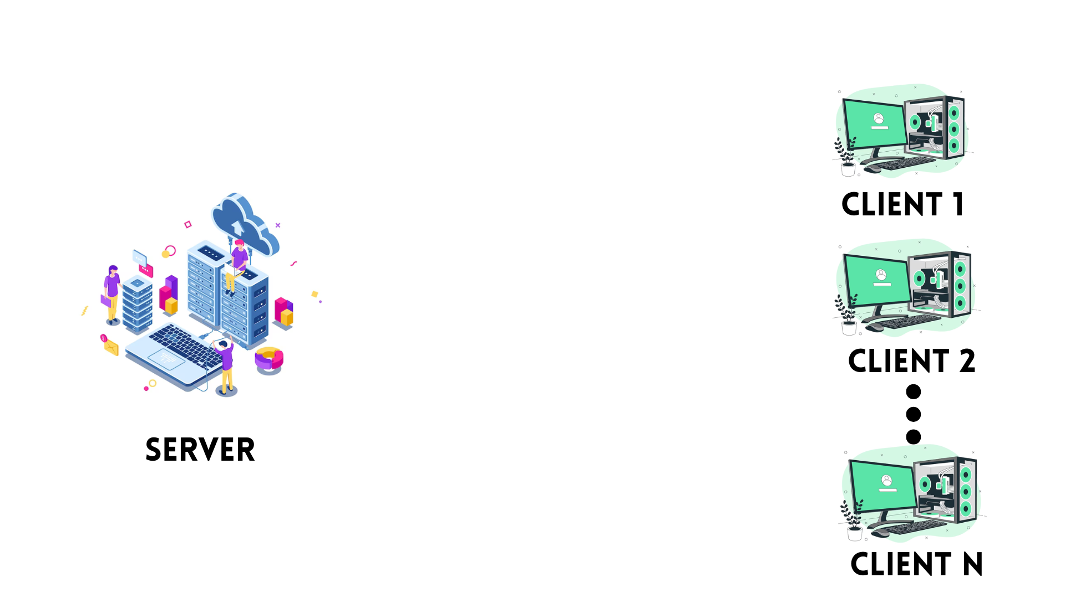
OVERALL SCENARIO ARCHITECTURE
ATTACKERS
REQUEST

Slide 9


SYSTEM ARCHITECTURE
SERVER
FIREWALL
CLIENTS
REQUEST
GENERATE LOGS
GENUINE CLIENTS
ATTACKERS

Slide 10












TOOLS USED

Slide 11

WEBSITE :

Slide 12
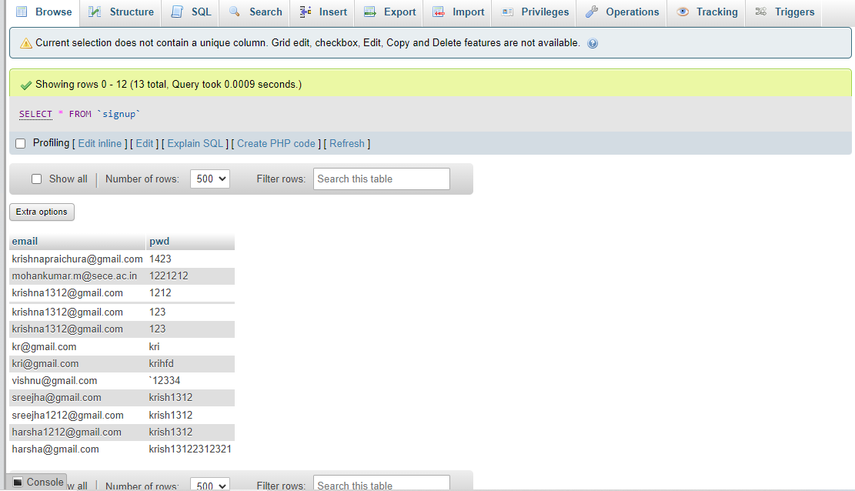
DATABASE :

Slide 13
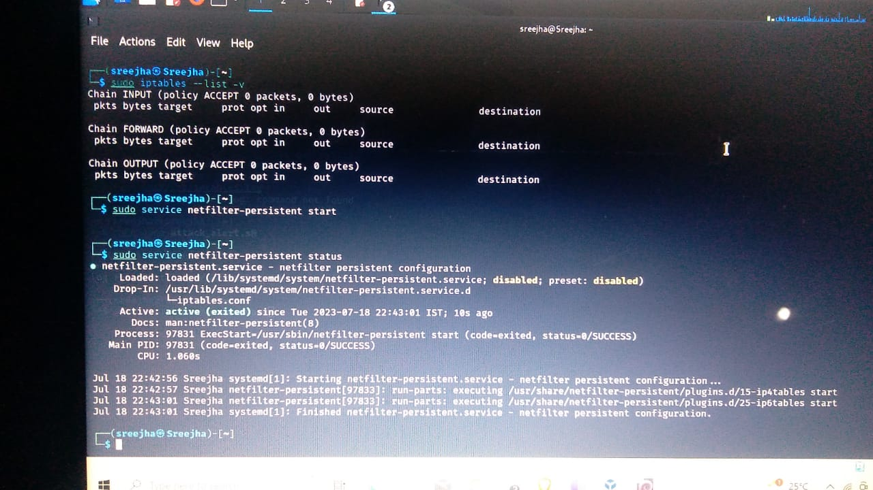
FIREWALL BASIC CODE :

Slide 14
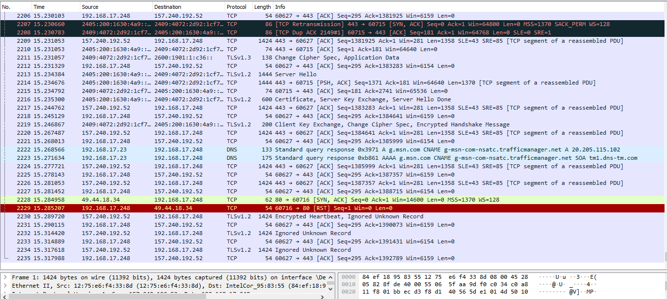
NETWORK TRAFFICKING :

Slide 15
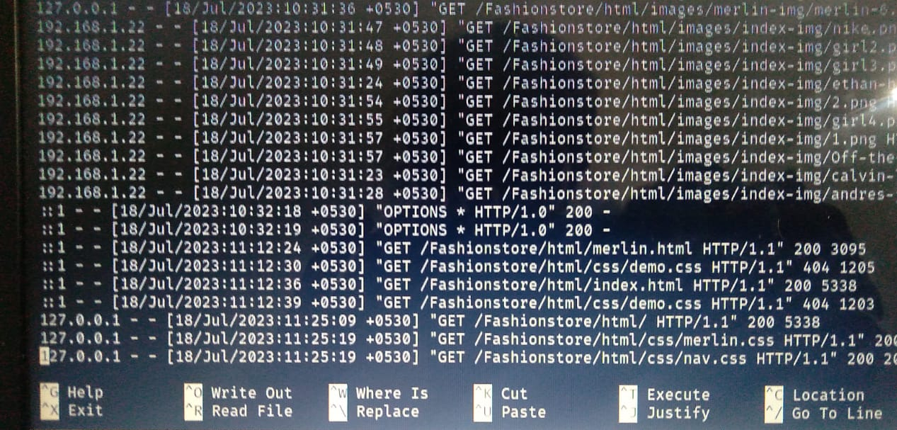
LOG GENERATION :

Slide 16
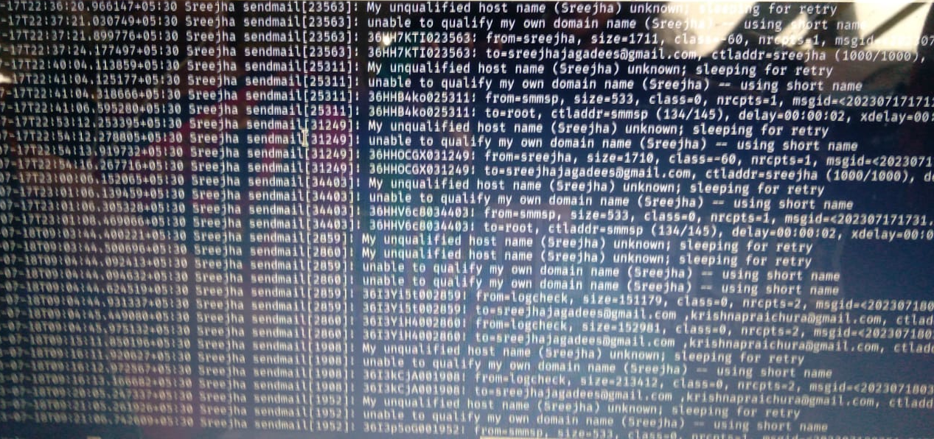
MAIL GENERATON :

Slide 17
CONCLUSION & FUTURE ENHANCEMENT
By using different tools of Kali Linux a firewall has been successfully and effectively implemented to stop the Distributed Denial of Service(DDoS) attacks, giving a highly efficient stop in downing the web service and a log generation have been done in improvising to know whether the origin.
This is from the same host or from the different hosts. Our future enhancement is to integrate the log with a mail service and mobile alert for the easy access of the server administrator and it will automatically off the server if someone tries to attack the website.

Slide 18
We thank to
Sri Eshwar College of Engineering Management and all the staffs who supported , motivated and gave us this wonderful opportunity to present here !!

